Slide 1
Lecture 23 Classes Pt. 3 Inheritance
CSC111: Introduction to CS through Programming
R. Jordan Crouser
Assistant Professor of Computer Science
Smith College

Slide 2
Outline
Friday: Classes pt. 1: attributes and methods
Today: Classes pt. 2: object-oriented programming
big idea
recap: classes
public vs. private
Lab: working with classes
Wednesday: Classes pt. 3: inheritance
child classes
overriding parent attributes / methods
Friday: Introduction to Algorithms

Slide 3

Lab 7: working with classes
How did it go?

Slide 4
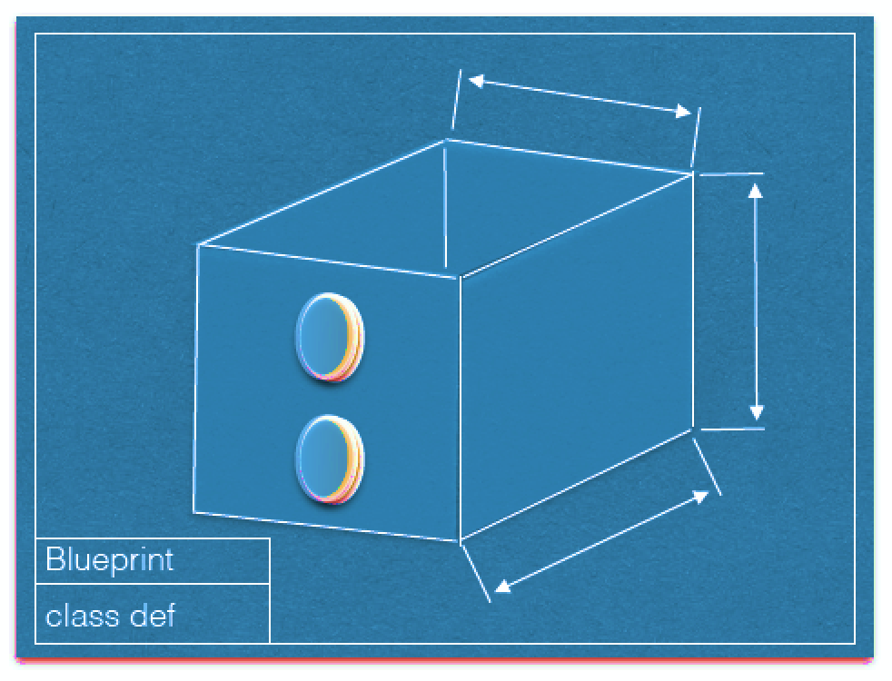
RECAP: class definitions (“blueprints”)
attributes
methods()
Image courtesy Dominique Thiebaut, Smith College

Slide 5
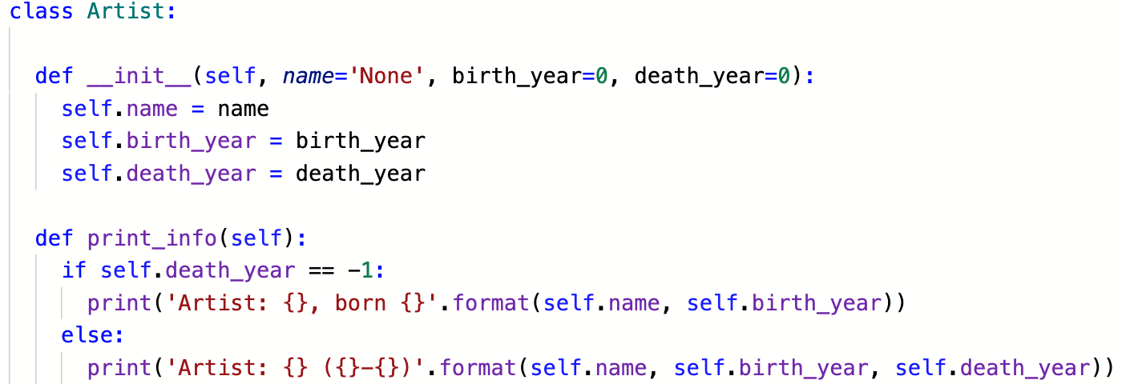
Coding the Artist class

Slide 6
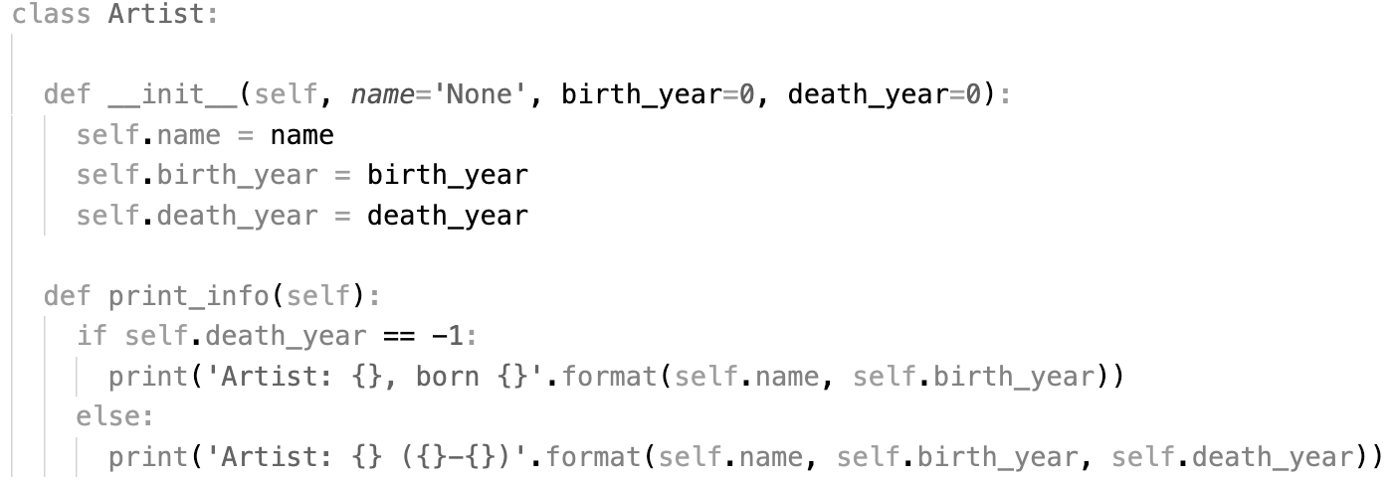
Coding the Artist class
the
constructor

Slide 7
Coding the Artist class
attributes

Slide 8
Coding the Artist class
default values

Slide 9
Coding the Artist class
method

Slide 10
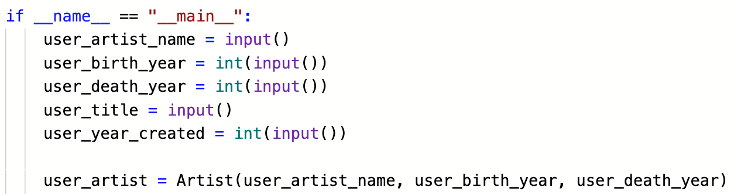
Creating an Artist instance

Slide 11
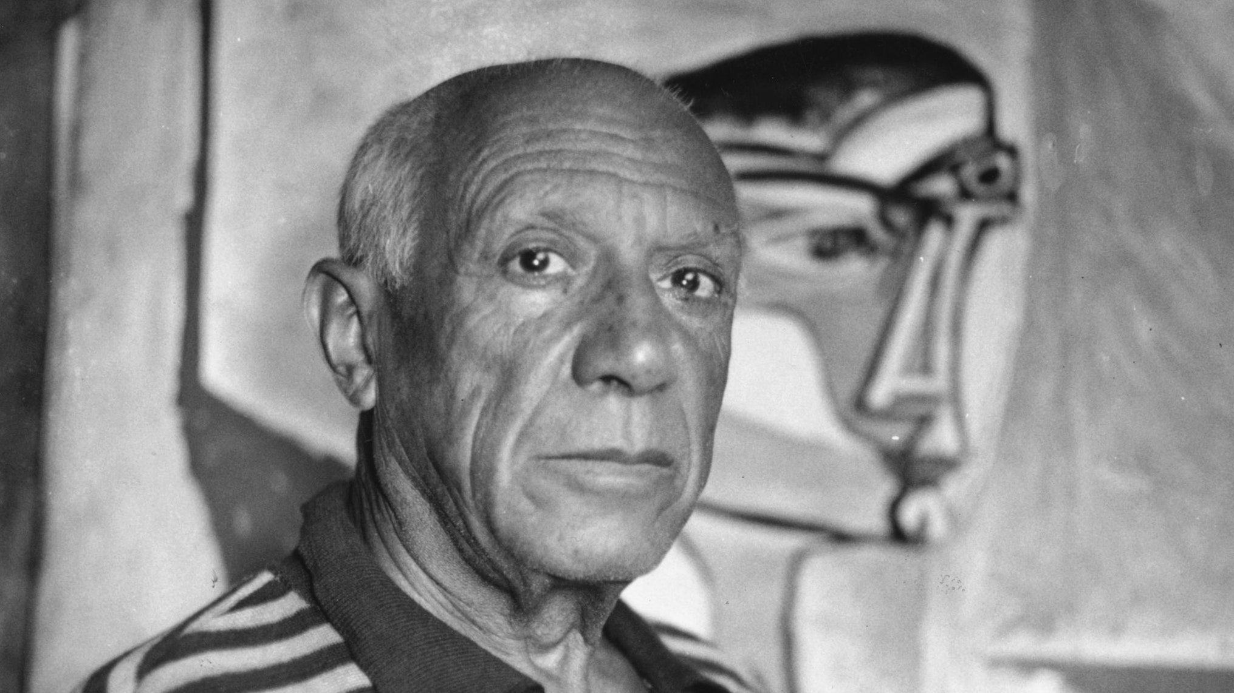



Lots of possible Artists

Slide 12
All from the same blueprint

Slide 13
Outline
Friday: Classes pt. 1: attributes and methods
Today: Classes pt. 2: object-oriented programming
big idea
recap: classes
public vs. private
Lab: working with classes
Wednesday: Classes pt. 3: inheritance
child classes
overriding parent attributes / methods
Friday: Introduction to Algorithms

Slide 14
Motivation
Dog

Slide 15
10 minute exercise: the Dog class
Write a class called Dog, with a constructor that takes in the following parameters:
name (the dog’s name)
age (the dog’s age in years)

Slide 16
Motivation
Dog
is also a
kind of
is a kind of
Dachshund
GreatDane

Slide 17
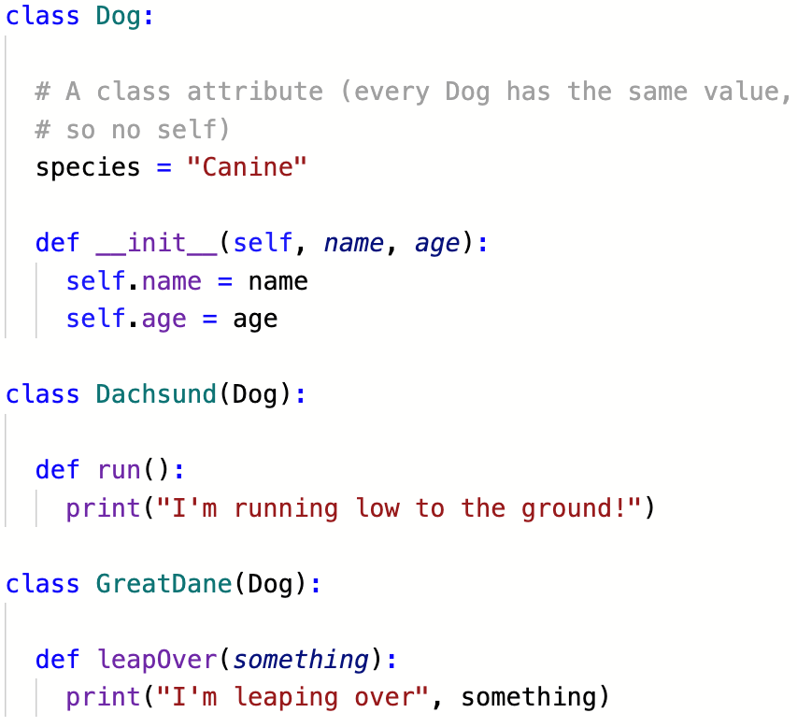
As (sub)classes

Slide 18
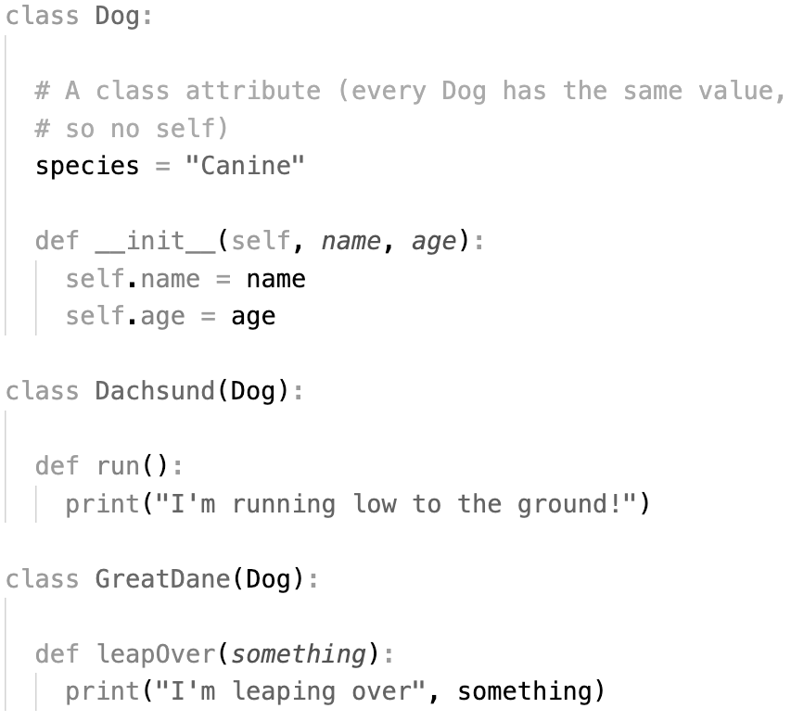
As (sub)classes
subclasses
“inherit”
all the
attributes
and methods
from their
parent class

Slide 19
As (sub)classes
they can also have
their own
attributes
and methods
separate from
their parent

Slide 20
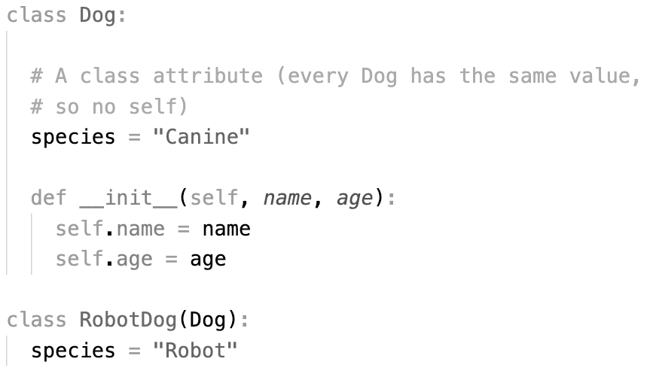
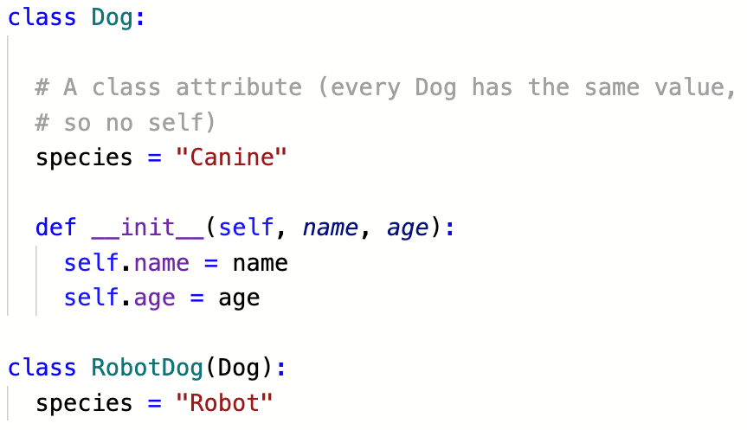
As (sub)classes
if necessary, they can override
attributes and methods
from their parent

Slide 21
Discussion
Why is this “inheritance” idea useful?

Slide 22
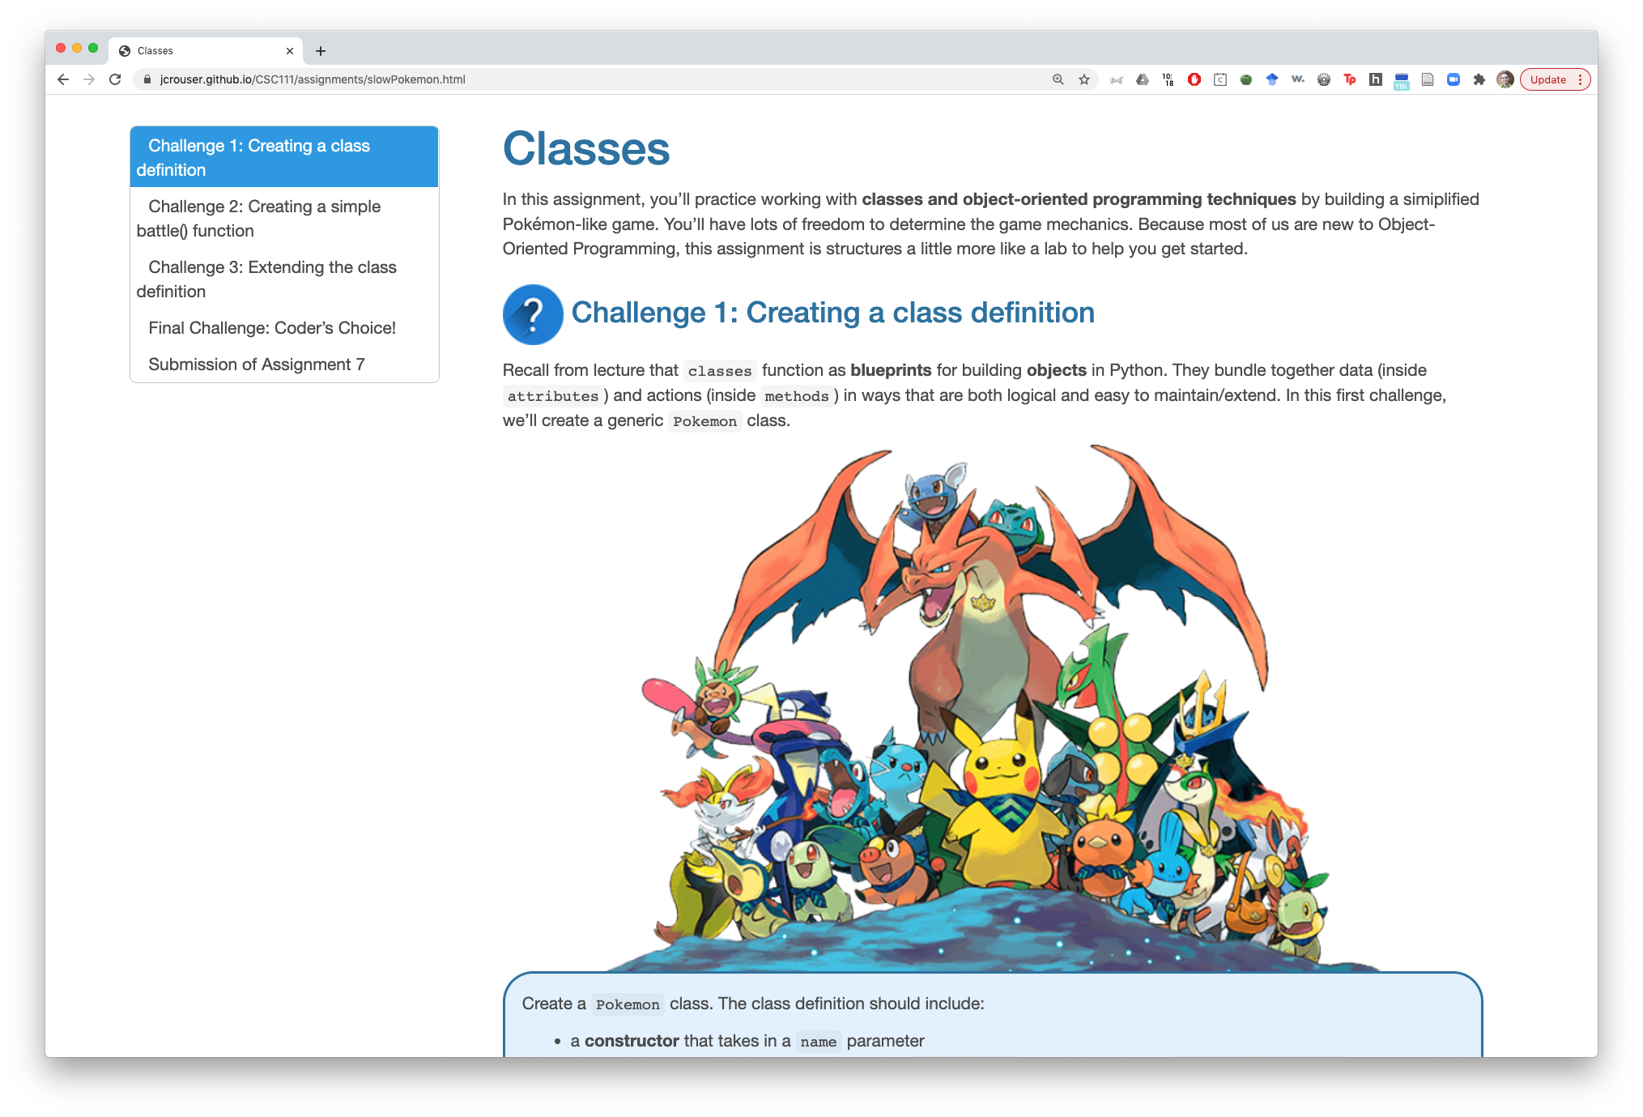
A6: Slow Pokémon (open a little early)

Slide 23

Common questions about the homework
0
max_hp
hp (“hit points”)
= how strong your Pokémon is
(bigger number → stronger)

Slide 24
Common questions about the homework
0
max_hp
attack_power
= how much damage your Pokémon does to another when attacking
(bigger number → causes more damage)

Slide 25
Common questions about the homework
0
max_hp
defensive_power
= how easy it is for your Pokémon to fend off damage from another’s attack
(bigger number → takes less damage)

Slide 26

Common questions about the homework
p2.attack(p1)
p1.defend()
0
max_hp
current_hp

Slide 27
Common questions about the homework
p2.attack(p1)
some (+) amount related to
p2.attack_power and
p1.defensive_power
0
max_hp
current_hp

Slide 28
Common questions about the homework
p2.attack(p1)
0
max_hp
current_hp

Slide 29
Common questions about the homework
fainted = True
0
max_hp
current_hp

Slide 30
Common questions about the homework
p1.revive()
0
max_hp
current_hp

Slide 31
Outline
Friday: Classes pt. 1: attributes and methods
Today: Classes pt. 2: object-oriented programming
big idea
recap: classes
public vs. private
Lab: working with classes
Wednesday: Classes pt. 3: inheritance
child classes
overriding parent attributes / methods
Friday: Introduction to Algorithms

